Slide 1

AGILE REQUIREMENT ENGINEERING
Lecturer: Prof. Dr. Jens Lüssem / Michael Mielke
Seminar: Agile Requirement
SS 2015
Murad Eminov 922154
Abdul Razak shaik 926317
Chetankumar Dobariya 924294
Khaled Mosharraf 923524
Chandni Jariwala 924275
Amir Doorandish 923724

Slide 2
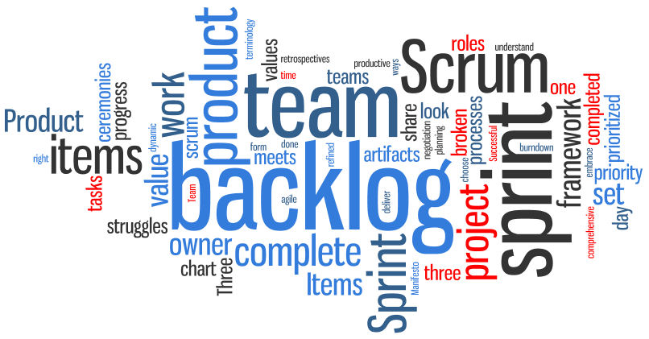
What is agile development?
-> Methodology
-> Frequent
-> Simple and Effective
-> Time-Boxed
-> Very Collaborative

Slide 3
Overview of project
Our Project is about software development in Bike Rent Company.
This Company decides to rent different types of Bike in different locations (Station) in Kiel.
This project includes regular steps by Agile Development Engineering framework.
1- interview people 8- Test Case
2- Define Persona 9- Planning poker
3- Develop an empathy map
4- Define user stories
5- Prototype
6- Create Product Backlog
7- First sprint Backlog

Slide 4
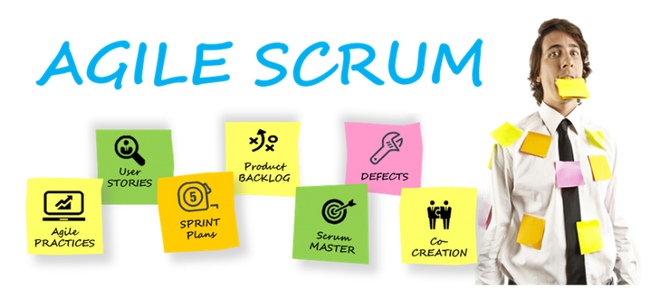

Slide 5
WHAT IS SCRUM
Scrum is an iterative and incremental agile software development framework for managing product development.
It defines "a flexible, holistic product development strategy where a development team works as a unit to reach a common goal"

Slide 6

ROLES IN SCRUM
Product owner
Scrum master
Scrum team
Designers
Programmers
Testers
Stakeholders
Customers

Slide 7
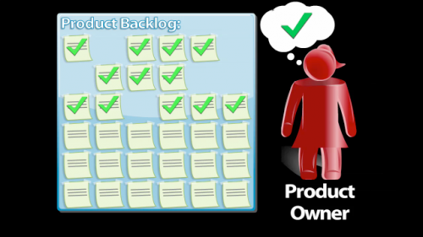
PRODUCT OWNER
Manages product backlog
Prioritizing according to business value
Ensure that the product backlog is visible transfer and clear
Negotiates priorities, scope ,funding and schedule
Provide vision and act as behalf of customer

Slide 8

SCRUM MASTER
Provide release backlog
Responsible for produce sprints with time frame
Responsibilities to remove impediments
Ensure the team is working well together
Provide supportive learning environment
Enforcer of rules of scrum
Often chairs key meetings and challenges the team to improve
Servant leader

Slide 9

SCRUM TEAM
Designers
Design the software
Programmers
Develop the software
Testers
Identify bugs and defects in the software

Slide 10
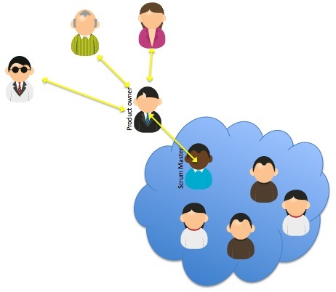
STAKEHOLDERS
End users
Customers
Purchasers
Managerial authorities
Product Owner should be gateway

Slide 11

EVENTS IN SCRUM
Sprint
Sprint Planning Meeting
Daily Scrum Meeting Retrospectives

Slide 12
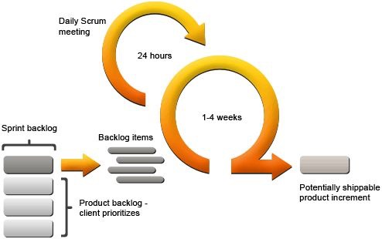
SPRINT
Sprint is a set period of time during which specific work has to be completed
Sprint is normally between 1 week and 1 month
Basic unit of development is scrum
It is time box effort
3 Meetings – Planning ,Daily Scrum, Review
Result in shippable and demonstrative code
Product demo

Slide 13
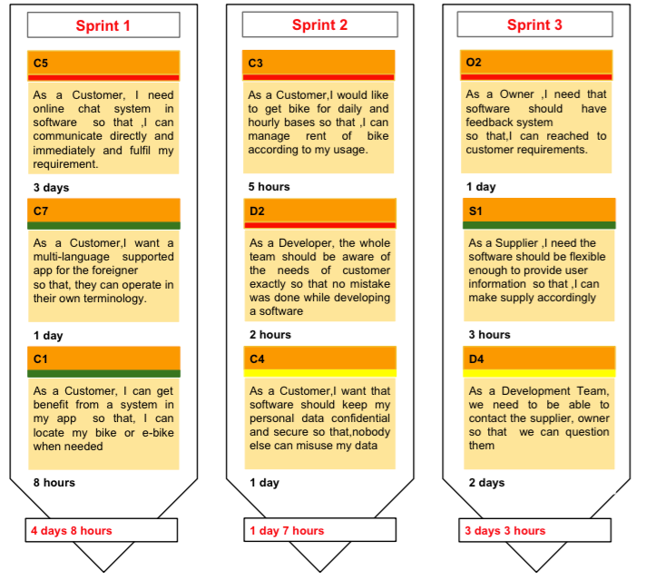
SPRINT

Slide 14
Types of questions in Interview
1.Availability of time
2.Location
3.Online register
4.Personal details
5.Previous experience
6.Suggestion
7.Ability of time

Slide 15
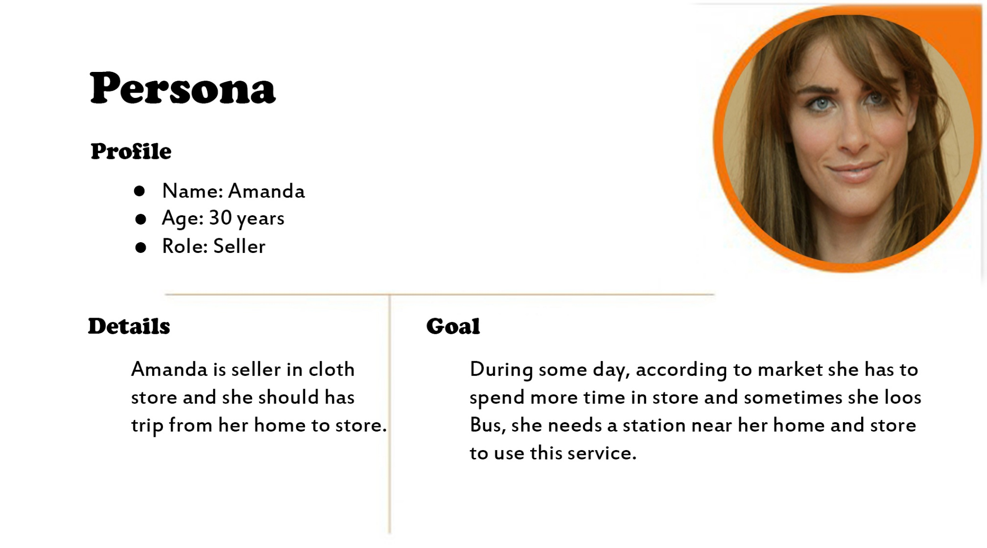
PERSONAS

Slide 16
Empathy map
Thinking & feeling about their worries or aspirations?
Hearing while using our product, from their friends or boss?
Seeing while using our product in their environment?
Saying & doing while using our product in public or in private?
Experiencing as a pain point or fear when using our product?
Experiencing as a positive or gain when using our product?

Slide 17
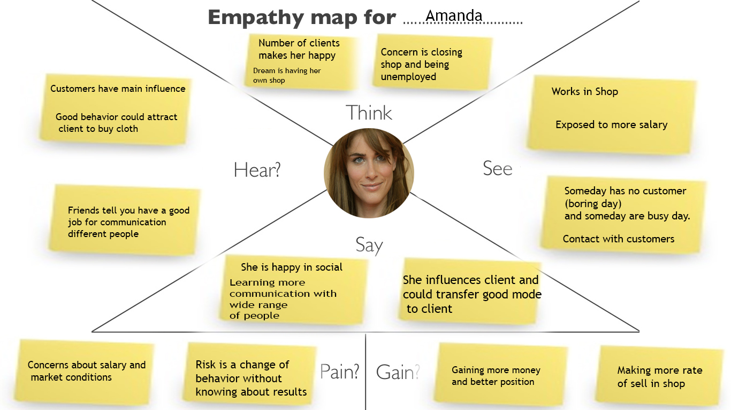
empathy

Slide 18
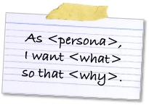
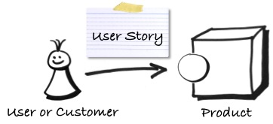
User story
As Customer
As Developer
As Owner

Slide 19
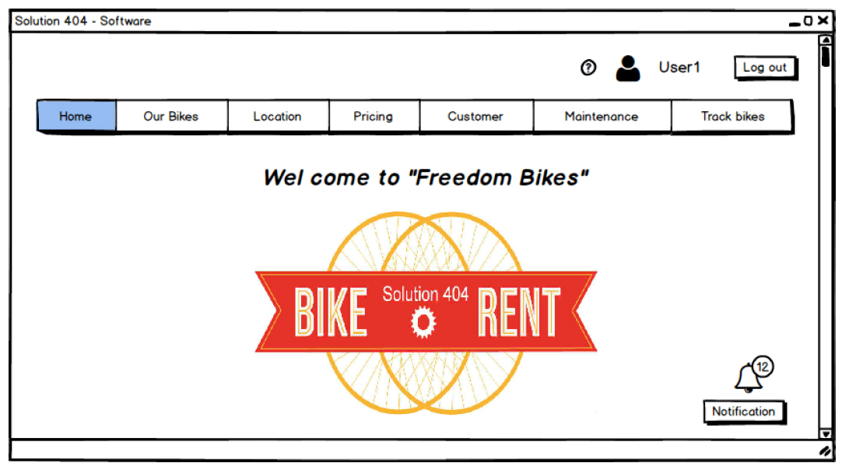
software PROTOTYPE

Slide 20

app PROTOTYPE
My role in Scrum Team: Developer , Backend developer
My activities: Develop App prototype, Contribute to Test Cases
Task 5:
“Create a non-functional prototype based on your user stories. Please use story boards in order to visualize business processes.”

Slide 21
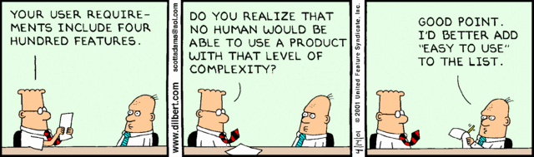
app PROTOTYPE
My activities began as soon as:
All interviews containing requirements from the user’s regarding the Bike/E-bike renting system were collected and analyzed
An idea of desired product was obtained, based on user requirements

Slide 22
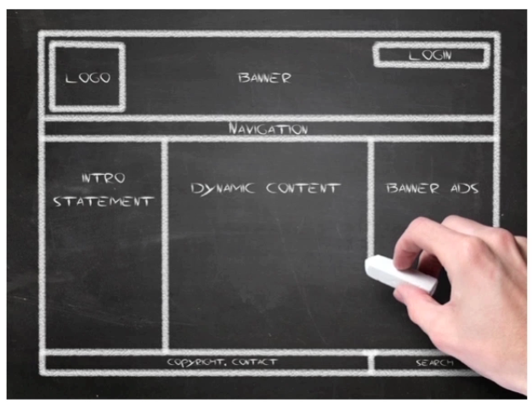
app PROTOTYPE
PROTOTYPING

Slide 23
app PROTOTYPE
Software prototyping :
….. is the activity of creating prototypes of software
applications, i.e., incomplete versions of the software program being developed.
and has several benefits :
The software designer and implementer can get valuable feedback from the users early in the project
The client and the contractor can compare if the software made matches the software specification, according to which the software program is built.
It also allows the software engineer some insight into the accuracy of initial project estimates and whether the deadlines and milestones proposed can be successfully met (was especially useful during Planning Poker phase )

Slide 24
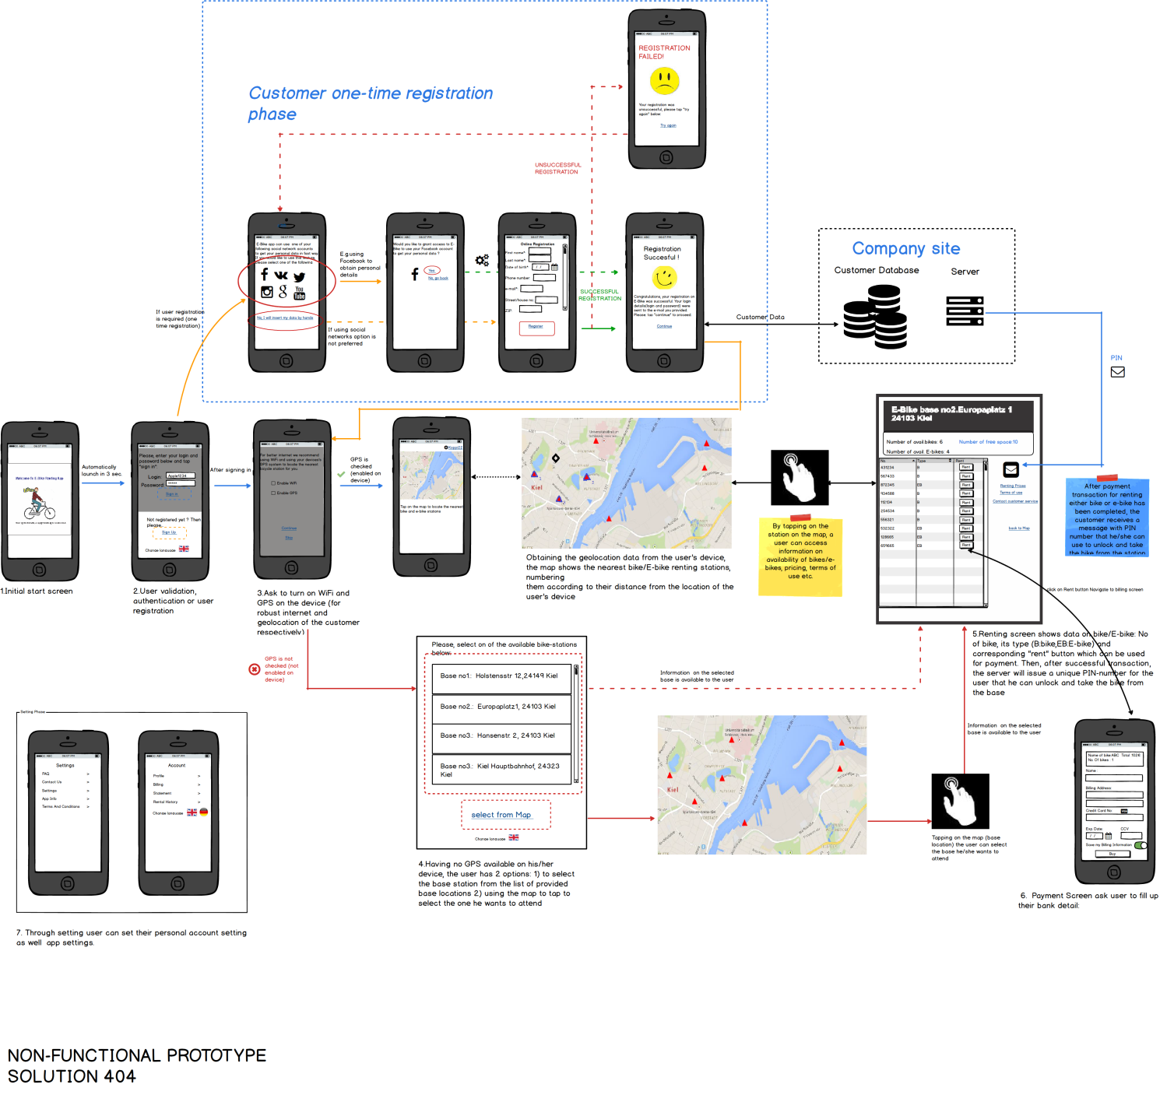
app PROTOTYPE

Slide 25

Interview on prototype
Interview people about your prototype.”
The interview on prototype :
All the interviewed on app prototype personas expressed their satisfaction with the prototype app and expressed fulfillment of their requirements
One persona expressed willingness of extra functionality – Bike Locator. Therefore, the user story was changed adding the new requirement and the new functionality was added in agile manner to the prototype v2.0
Tobias Kampfe:

Slide 26
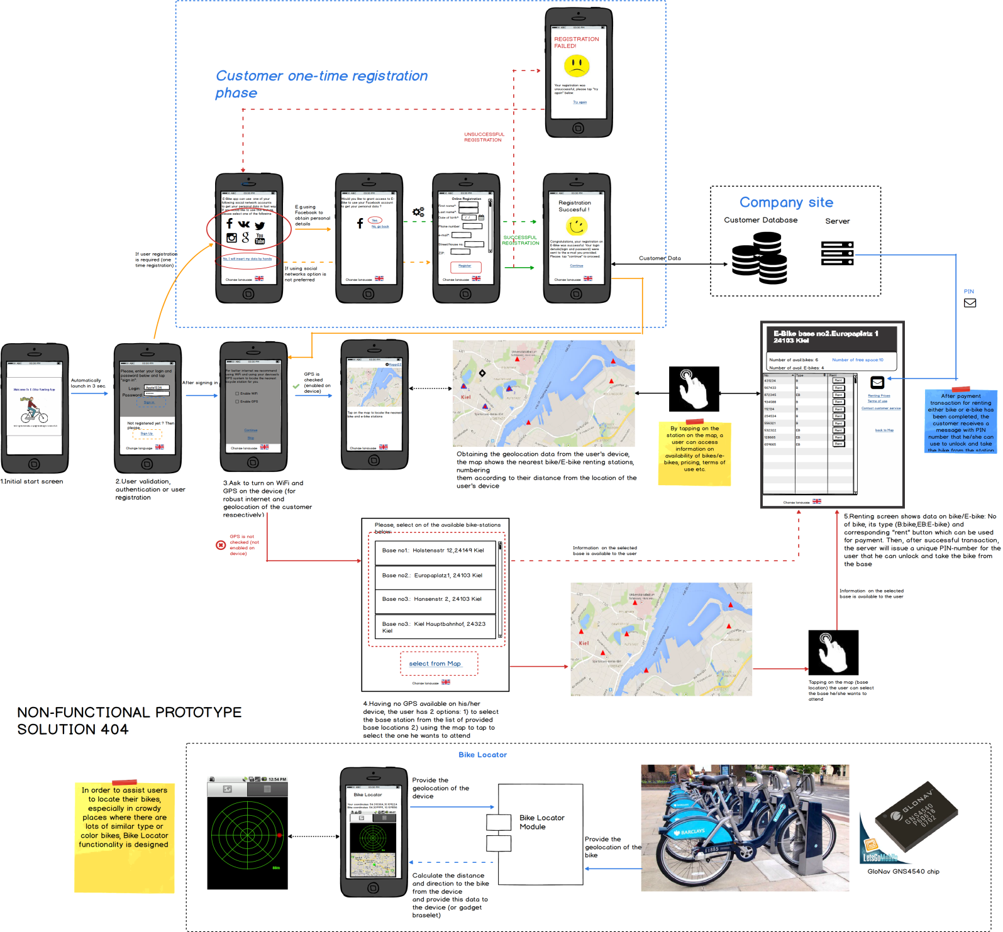
app PROTOTYPE
Solution 404

Slide 27
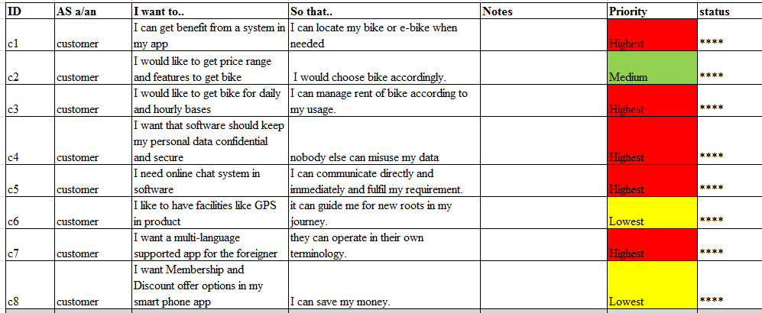
Product backlog

Slide 28
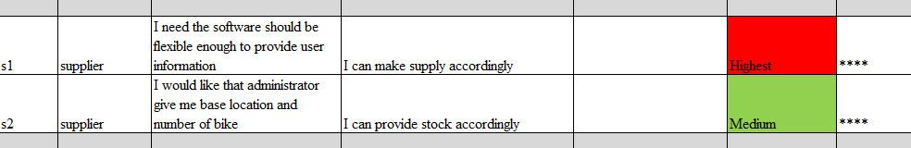
Product backlog

Slide 29
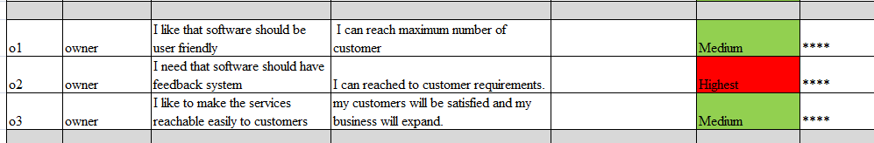
Product backlog

Slide 30
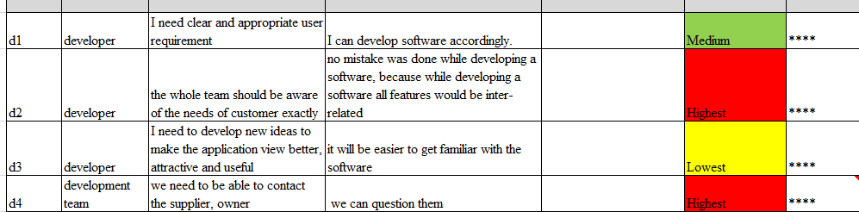
Product backlog

Slide 31
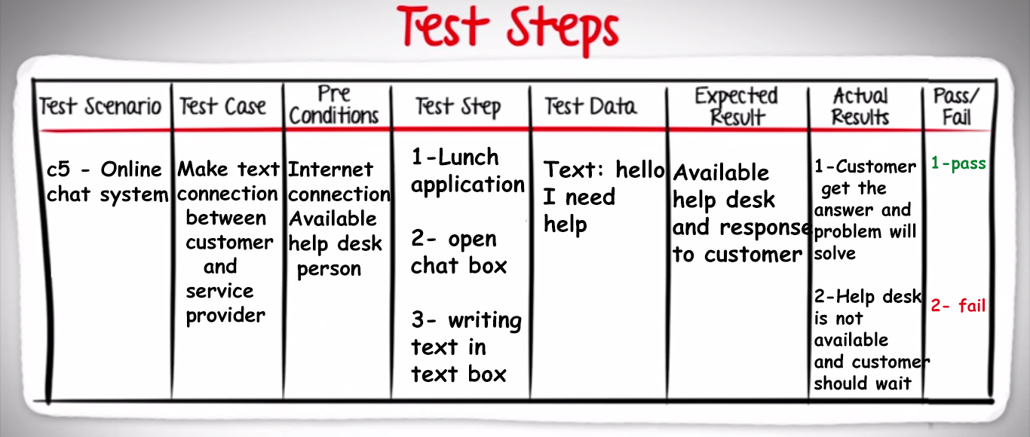
Test case

Slide 32
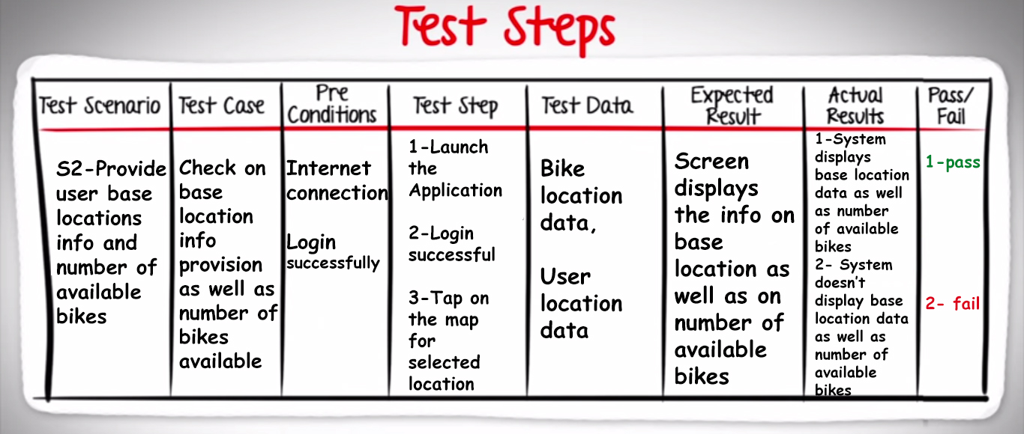
Test case

Slide 33
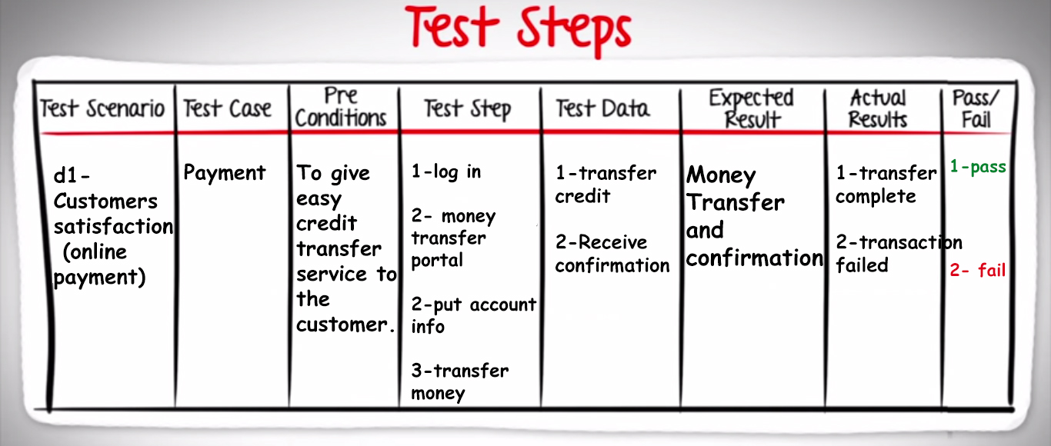
Test case

Slide 34
Planning poker
Planning Poker is a consensus-based estimating technique. Agile teams around the world use Planning Poker to estimate their product backlogs. Planning Poker can be used with story points, ideal days, or any other estimating unit. Here planning poker is used with number of ideal days.

Slide 35
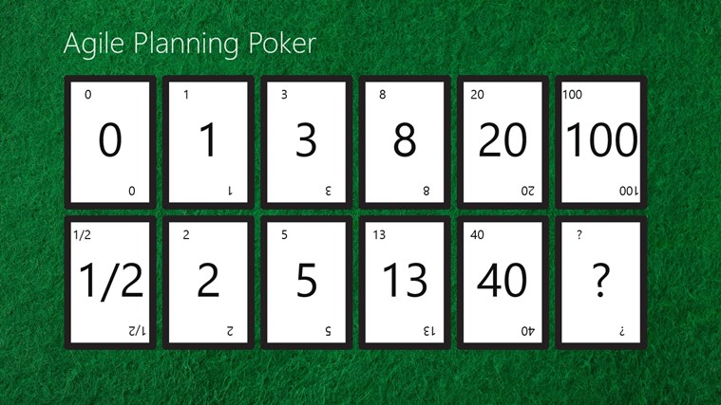
Planning poker

Slide 36
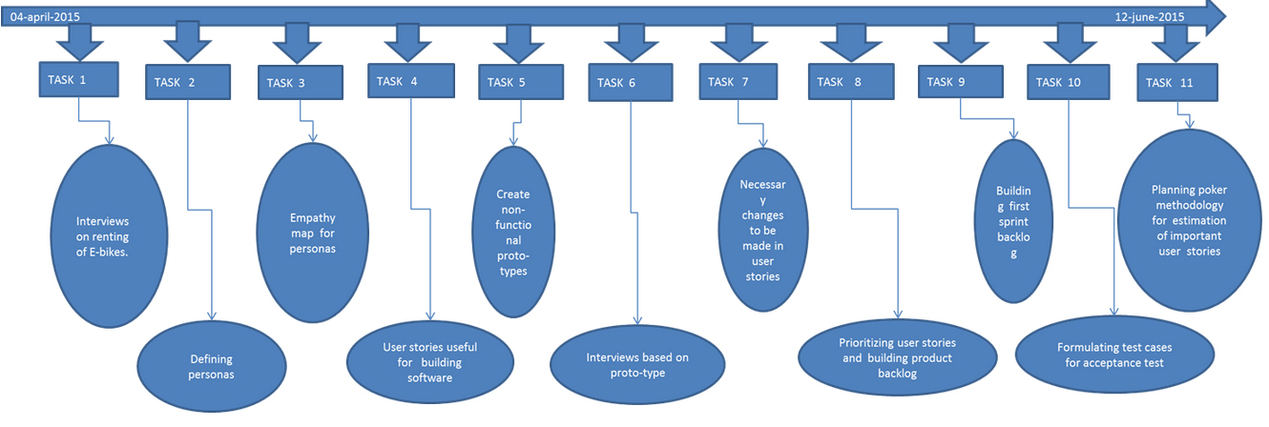
Roadmap

Slide 37
conclusion
agile methodology which is adaptable to change, people-oriented, speedy and responsive are well suit to the software development projects. However, company needs to consider which agile methods are beneficial for the company or some specific projects. The company can select different agile methods for different projects or just customize any features that match the condition of the company and the projects.

